Slide 1

Advertising Dynamics in Medicare Advantage
Da-Young Kim and Zhirui Li
David Meyers, PhD
Andrew Ryan, PhD

Slide 2
Project Overview
Aim: To investigate advertising dynamics (size, distribution, and impact of advertiser spending) in the Medicare Advantage space
Research Question: What is the extent of TV advertising in MA? What is the distribution of spending on advertising in MA and how does it vary across markets?
Four-Week Focus: Given the structure of the Nielsen Ad Intel Database, how do we identify “Medicare Advantage TV ads”?
Notes:
Came into project knowing our aim
Found that it was quite broad, so first task was to narrow to more actionable research question. Decided to focus on TV ads in 2019.

Slide 3
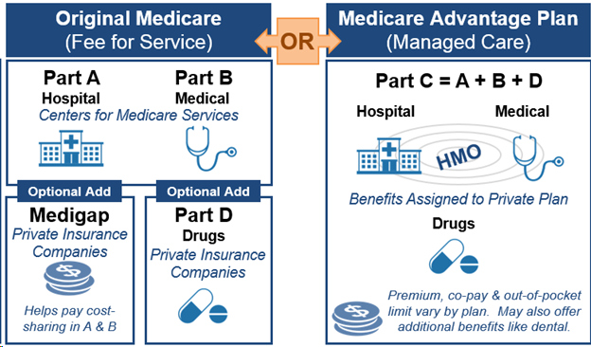
Background: Medicare Advantage
Motivation:
Medicare Advantage (MA) is steadily growing in popularity amongst seniors, and Medicare Advantage is expensive compared to traditional Medicare. Spending on advertising by health insurance companies may contribute to federal overspending on Medicare… where else could that money go?
Nielsen Ad Intel Data: large relational dataset containing entries of every ad that has been published on all mediums, including TV, Radio, Print, and more
Includes: spending, regional market breakdown, advertiser, brand information for each ad
Medicare Advantage (MA): program of traditional federally-supported Medicare that allows senior beneficiaries to receive Medicare benefits through private insurance companies
Notes:
Key terms to know
Adv of ™: greater choice of providers, access to another Medicare program, medigap to subsidize prescriptions
Adv of MA: lower premiums, more comprehensive coverage for people with preexisting conditions

Slide 4
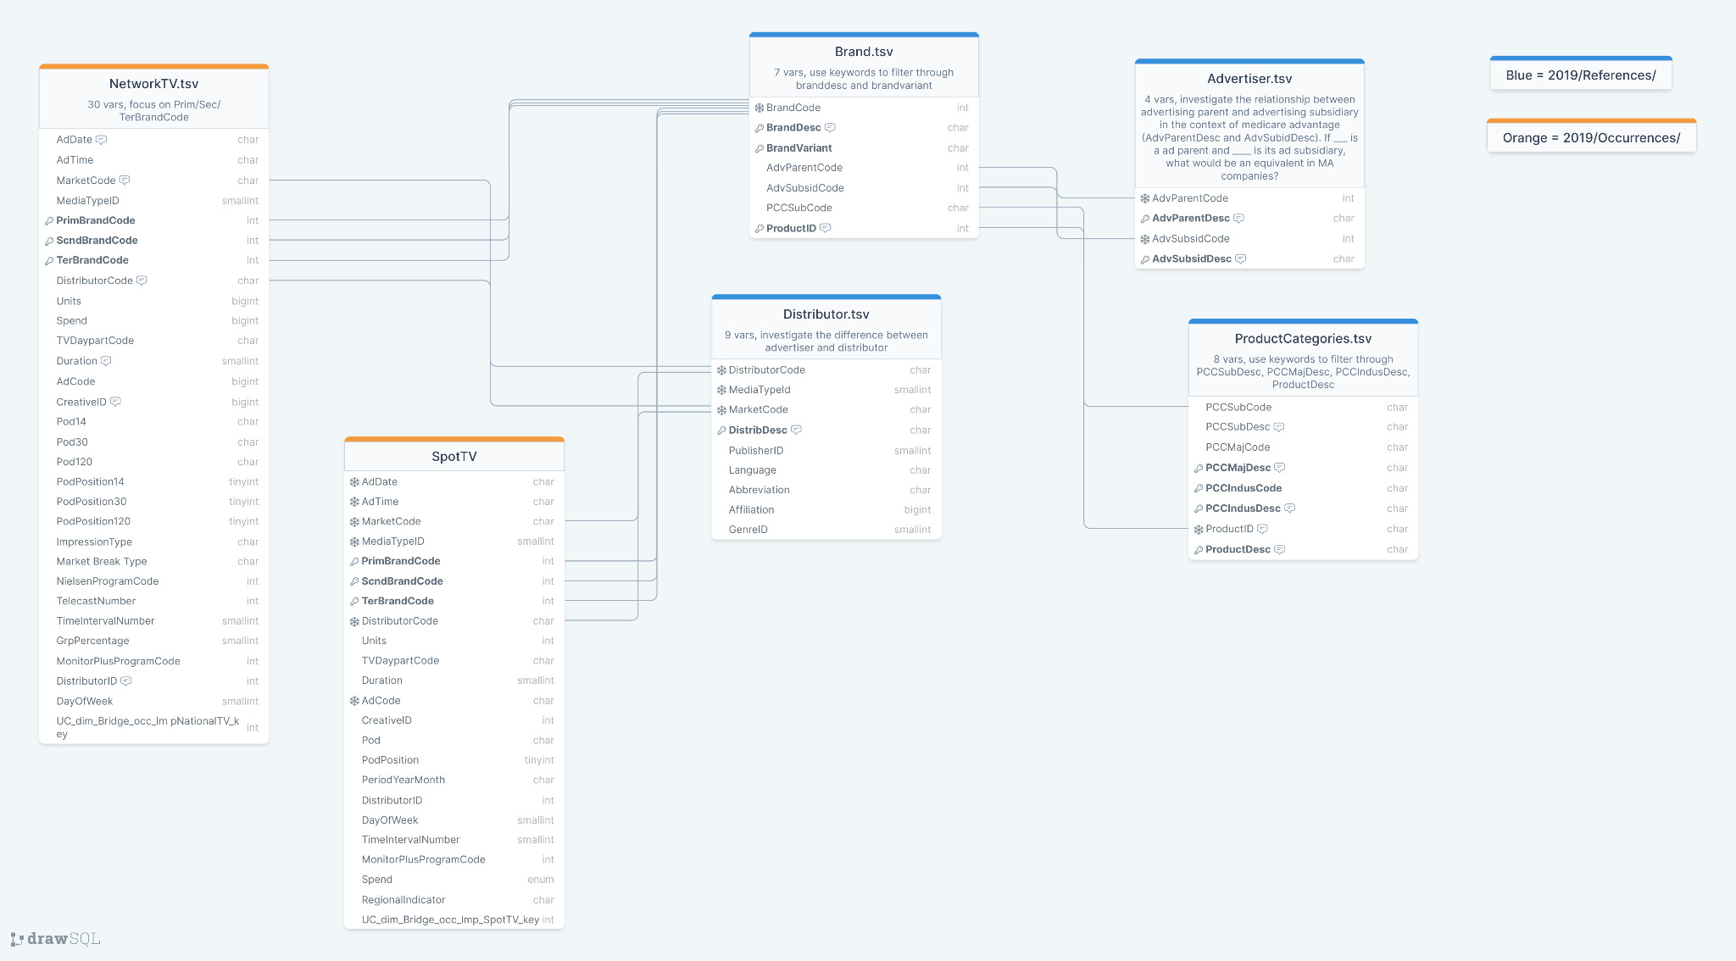
Nielsen Relational Database
Diagram created in DrawSQL
Notes:
Started with occurrence data, investigated each variable to identify most relevant using manual.
These are the files we deemed most relevant to our focus.
Lots of files linked across directories.

Slide 5
Methodology
First Approach:
Filter Occurrences by MA-related Brand Codes
Filter Advertisers by Known Companies
Link Advertisers to Brand Codes
Filter Advertiser-linked Brands by MA-related Keywords
Second Approach:
Filter Brands by MA-related Keywords
Link Brand Codes to Advertisers
Identify All Parent Advertisers that are Associated with MA-related Brands

Slide 6
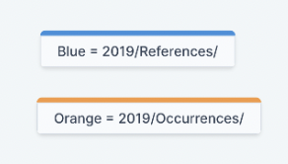
Our Filtering Strategy
Challenge: designing a strategy for identifying MA TV ads that balanced sensitivity and specificity
Filtering brands and advertisers for “MEDICARE” and “MEDICARE ADV”
Too specific, sensitive enough
Using known MA companies as advertisers to identify MA-related health insurance brands
Specific, but not sensitive enough
Filtering brands by MA-related keywords to identify MA-related advertisers and ultimately all MA-related brands
Keywords: “MEDICARE”, “MEDICARE ADV”, “SENIOR”, “65”

Slide 7
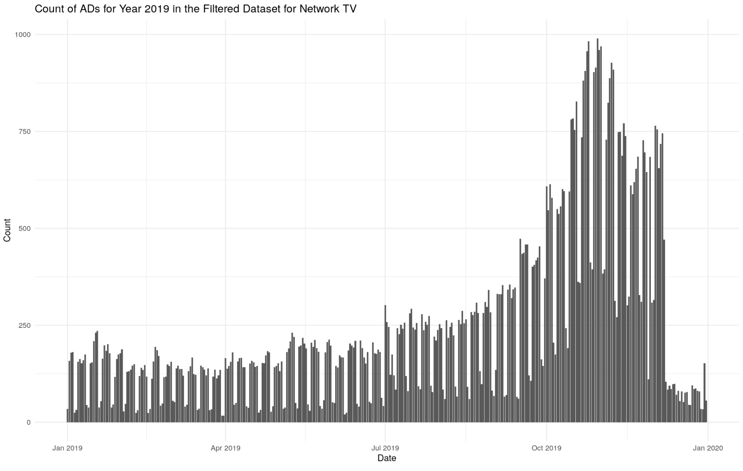
Results

Slide 8
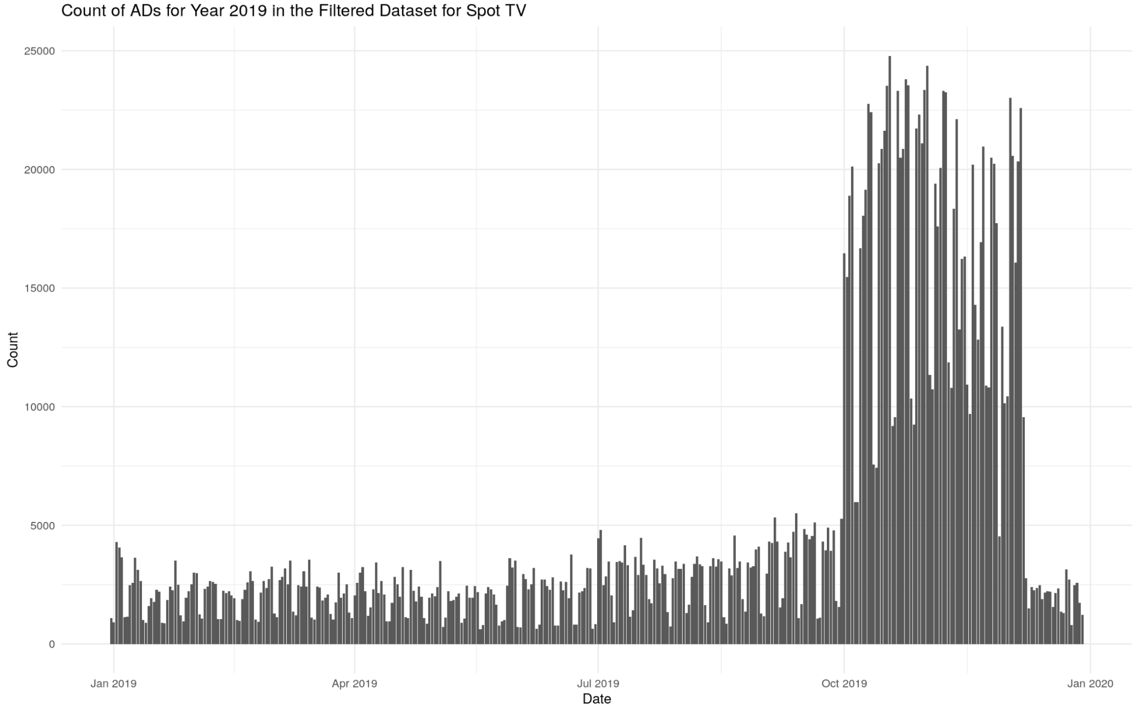
Results

Slide 9
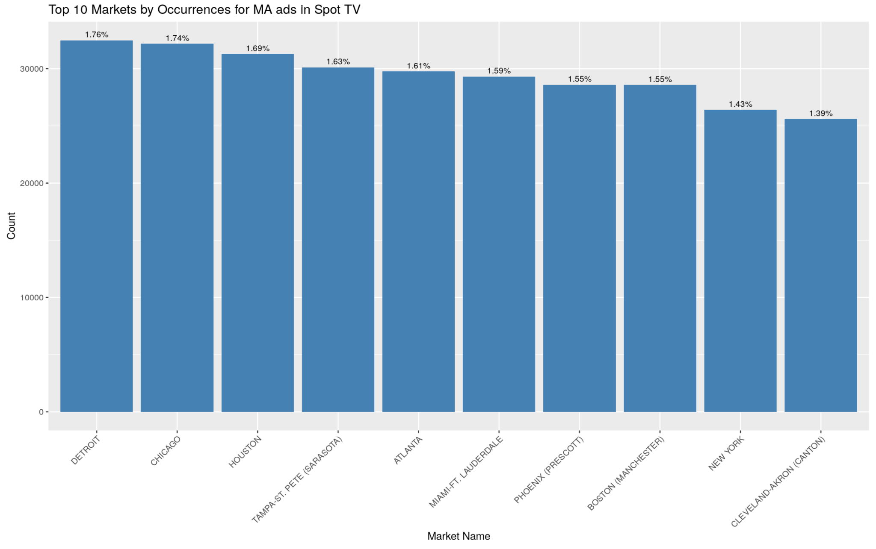
Results

Slide 10
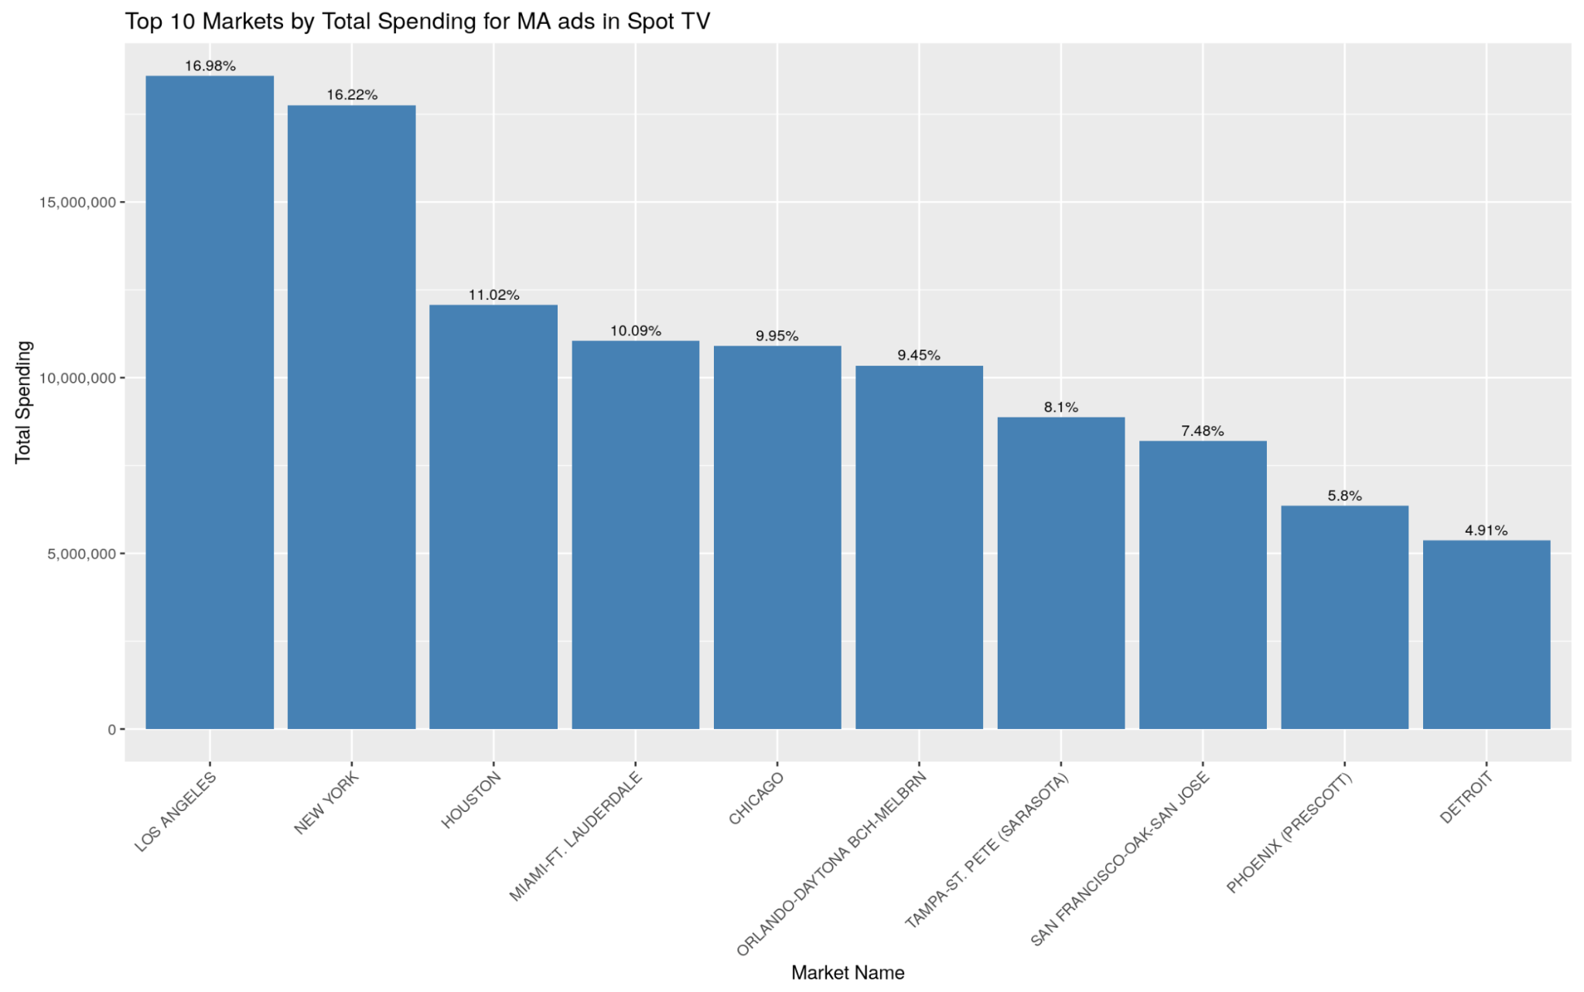
Results

Slide 11
Discussion
Future steps:
Perform filtering strategies on Nielson datasets for the years 2017 and 2018
Conduct filtering analyses on Nielsen datasets for a broader range of ad mediums, beyond just Network TV and Spot TV
Using parallel processing to speed up computing
Limitations:
We cannot perform machine learning analyses due to the structure of our datasets, no meaningful variables to predict or model
Identifying criteria requires further validation

Slide 12
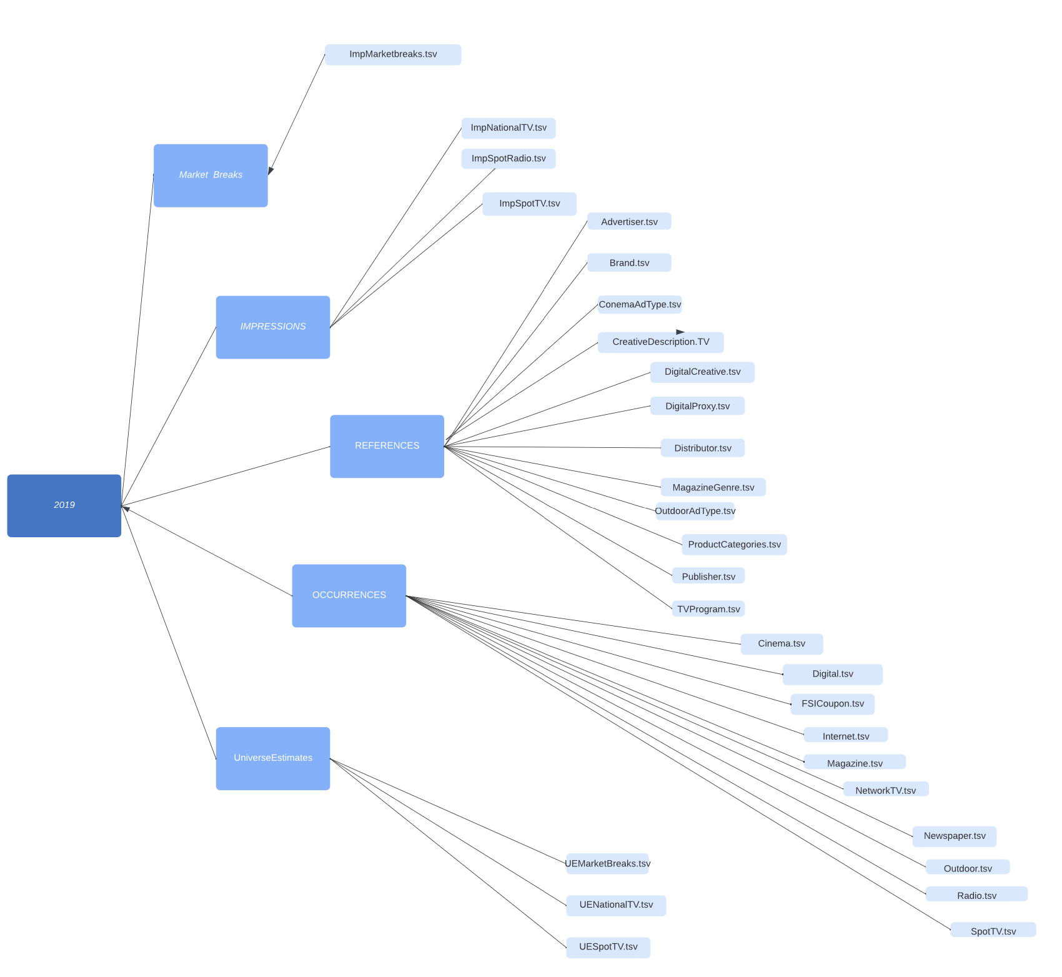
Discussion: Big Data
2019 ADs Folder
The Nielsen database is big and complex.
To manage the size and breadth of the database, we…
Focused on 2019 data and TV ads: Network TV (~4GB) and Spot TV (~20GB) ad occurrences
Used OSCAR to run R code and explore the files
High processing power, speed, and RAM
Used the Vroom package to load in ~318mil entries in ~3 mins
Optimized code: select columns, computing calculations
Notes:
Approx. 92 GB in 2019 ad data

Slide 13
Machine Learning Approaches
Initial thought: using k-modes clustering to help identify MA TV ads
Attaching factor labels by frequency of MA-related terms to cluster brand and/or advertiser data
Limitations: descriptions are short, having to pursue natural language processing or regex processing to create factors
→ Conclusion: resources could be better used elsewhere!
Future ML applications: predicting which TV ad occurrences are actually MA-related based on a validated training dataset, using ML-assisted Multiple Correspondence Analysis (MCA) or k-modes clustering during MA utilization analysis

Slide 14
Thank You for Listening! Questions?
Special thanks to Dr. Andrew Ryan, Dr. David Meyers, and Haroon Janjua for expert domain knowledge and technical mentoring. Our work was only made possible because of Arlene Correa, Ashley Gomez, and Dinka Morillo at the Center for Advancing Health Policy through Research (CAHPR), Brown School of Public Health.

